Slide 1

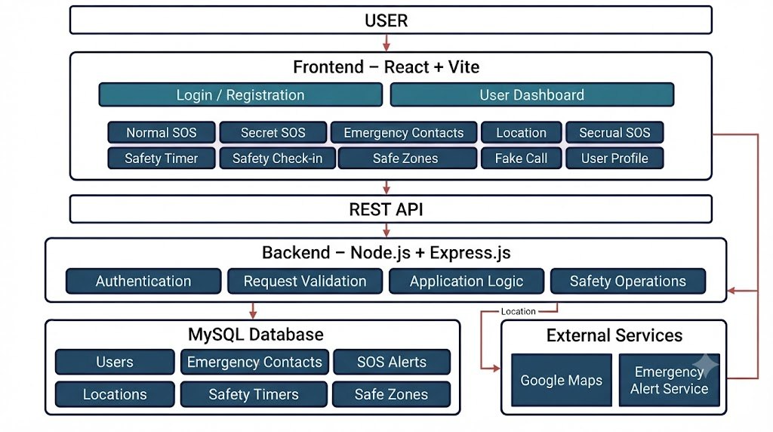
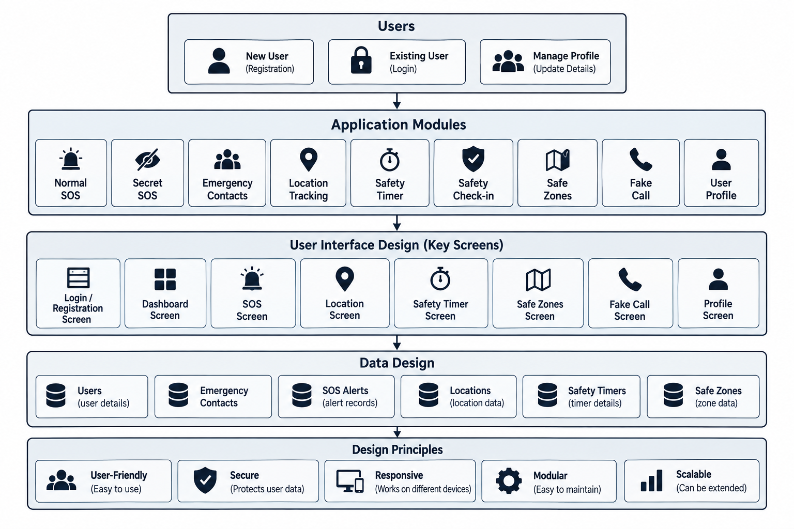
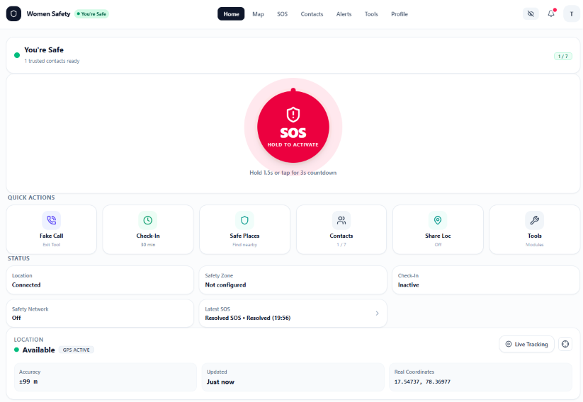
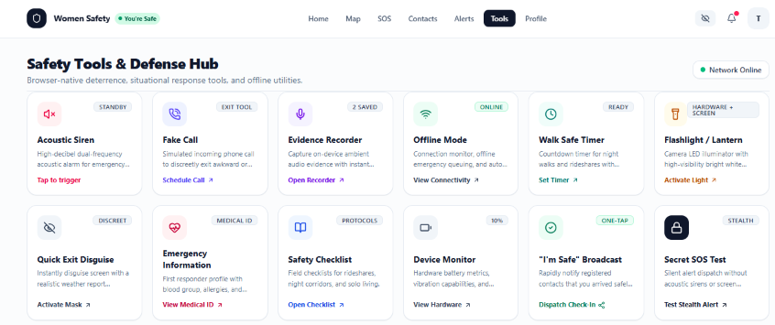

Women Safety App with SOS & Live Tracking
TeTeam ID: 13 | Section: S5 | Members: P.Hamsika – 2520030586, M.Thanishka – 2520030583
Guide: Dr. D. Ramya Krishna Database Systems Engineering and Distributed Backend Development (25CS1302E) | KLH Bachupally Campus, CSE | PBL 2026-27
Abstract
Tools & Technologies
Women Safety is a smart safety platform designed to assist women during emergency situations. It provides SOS alerts, trusted contacts, location sharing and safety services using React, Node.js, Express.js and MySQL.
Outcome: Provides quick emergency assistance through a centralized and easy-to-use platform.
Front-End: React, HTML, CSS, JavaScript
Back-End: Node.js, Express.js, REST APIs
Database: MySQL
Tools: Git, GitHub, Postman, VS Code, Draw.io
APIs: Google Maps API, Google Places API
Problem Statement & Objectives
Problem: Existing safety solutions often provide emergency alerts, contacts and location services separately, making quick assistance difficult during emergencies.
Objective 1: Provide quick SOS emergency assistance.
Objective 2:Enable trusted contact and location sharing.
Objective 3: Provide centralized safety services.
Scope:Women users, SOS, emergency contacts, location tracking, safety timer, safe zones and related safety features.
System Architecture
Existing vs Proposed System
Feature | Existing System | Proposed System
SOS Alert | Basic / separate services | Integrated SOS
Emergency Contacts | Limited management | Trusted contacts
Location Sharing | Separate applications | Integrated location
Safety Services | Multiple disconnected services | Centralized platform
Limitation / Gap | Features are scattered | Unified safety system
ER Diagram & Database Design
Feasibility Study
Technical: Required skills, tools and platforms are readily available for development.
Economic: Uses an open-source technology stack with free or low-cost hosting.
Operational: Simple to use, maintain and suitable for user requirements.
Schedule: Development and testing can be completed within the semester timeline.
Implementation Screenshots
Results & Testing
Conclusion
Future Scope
Key Outcomes: SOS, emergency contacts and location features implemented successfully.
CRUD & Validation: Database operations and input validation tested successfully.
Performance: API responses and system performance verified.
Achieved: Integrated SOS, emergency contacts and location services into one platform.
Objectives: Provides quick emergency assistance, secure data management and accessible safety
Real-Time Tracking: Enable continuous live location sharing during emergencies.
Smart Alerts: Add AI-based danger detection and automatic emergency notifications.
REFERENCES
React Documentation, Node.js & Express.js Documentation, MySQL Documentation, Google Maps Platform Documentation, GitHub Documentation.

